Slide 1
Point-to-Point Protocol Overview

Slide 2
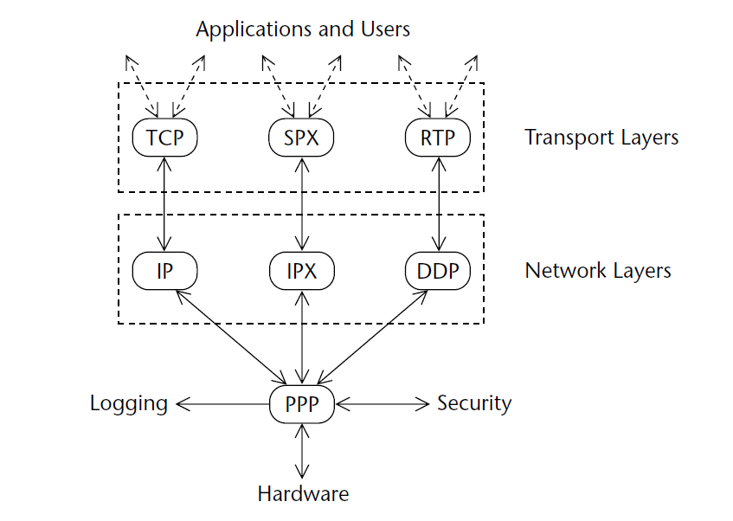
Networking Layers with PPP

Slide 3
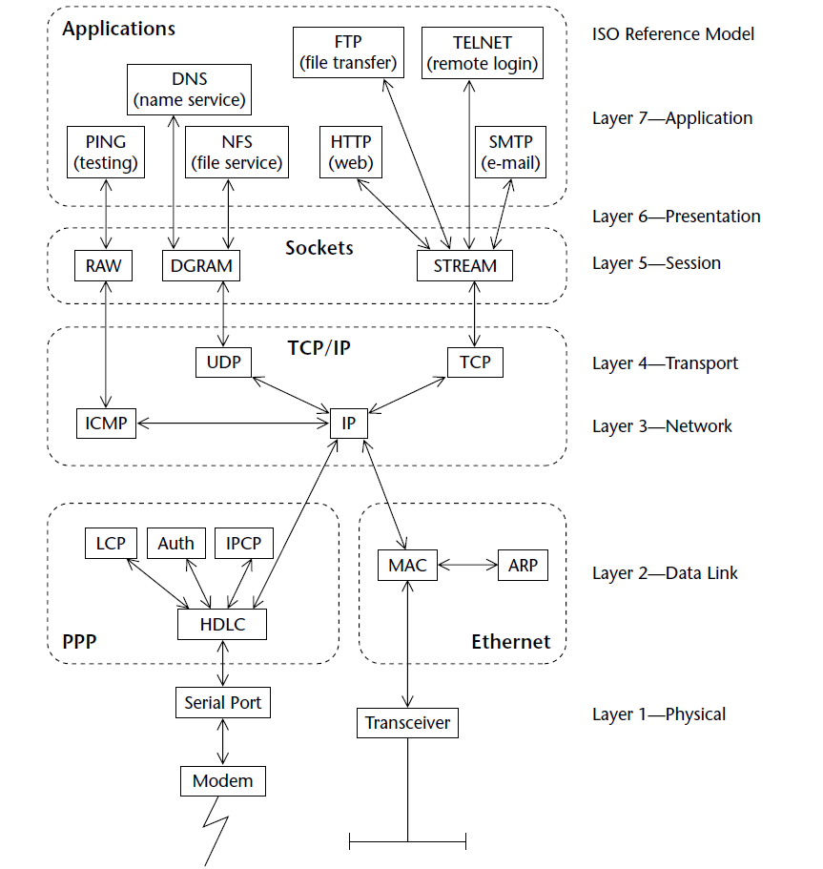

Slide 4
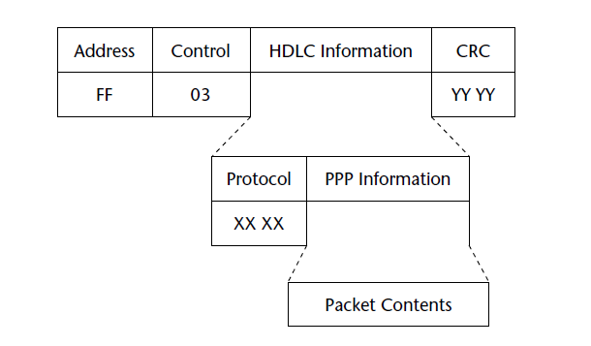
HDCL-PPP Frame

Slide 5
PPP in HDLC
asynchronous HDLC (or AHDLC),
used for all asynchronous lines, such as modems used on ordinary PCs
7E value is a frame delimiter
7D value is an escape character
bit-synchronous HDLC, and
on most telecommunications interfaces for PPP
“bit stuffing
octet-synchronous HDLC
used on special media with a default hardware interface that presents individual octets at very high speed
Octet-synchronous framing is essentially identical to AHDLC

Slide 6
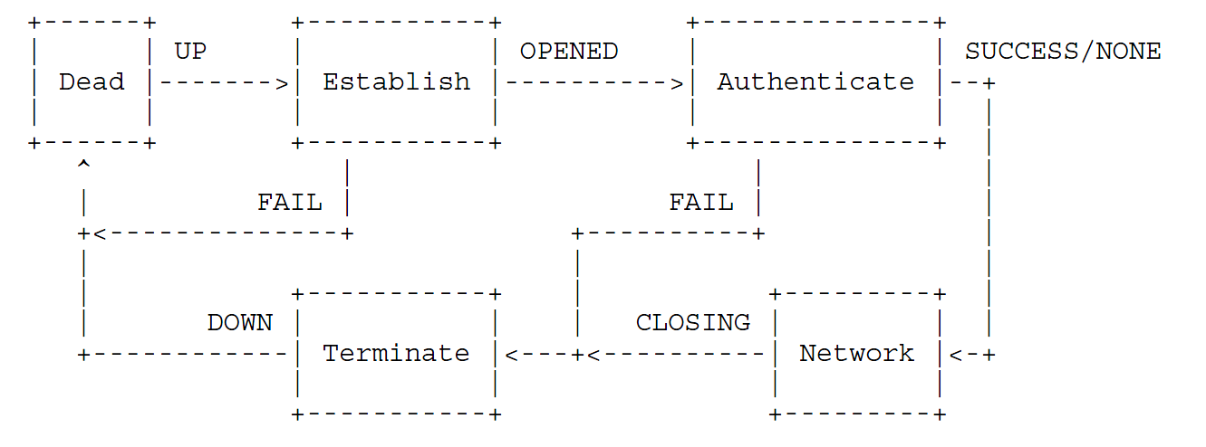
PPP Outline
Authentication Protocol and Link Quality
Management (LQM)
LCP negotiation
NCP negotiation (IPCP)

Slide 7
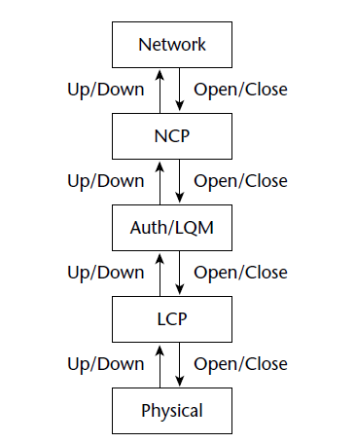
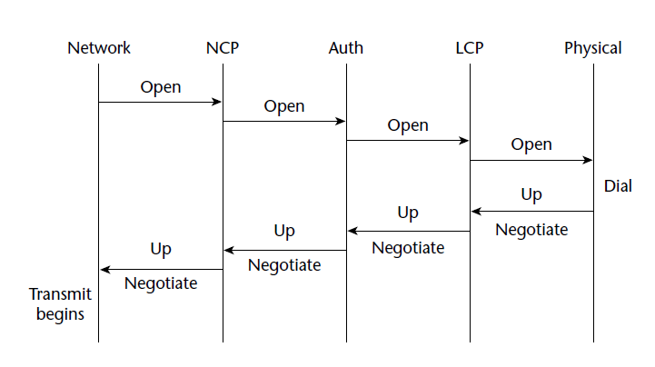
PPP phases as layers

Slide 8
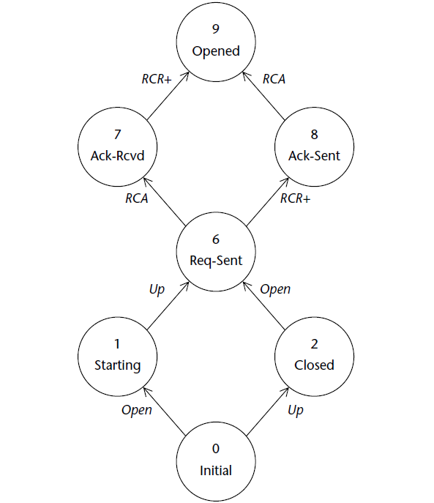
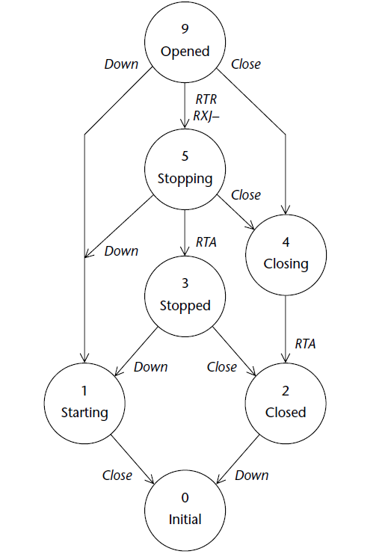

Slide 9
